Slide 1


File Handling

Slide 2


Slide 3


Slide 4
Revision
We can conclude that every program performs 3 basic operations.
Takes data as input
Performs computations based on the input
Displays/Stores the result
Notes:
After this lecture, you shall be able to explain the Hardware Components (that are input output devices, CPU and memory) and their role while computing any problem.

Slide 5
Revision
Write a Program that takes Distance (in kilometers) travelled by a car in Time (hours) and calculates its Speed (kilometer/hour).
#include <iostream>
using namespace std;
main()
{
int distance;
int time;
int speed;
cout << "Enter distance: ";
cin >> distance;
cout << "Enter time: ";
cin >> time;
speed = distance / time;
cout << "Speed is " << speed;
}
Notes:
After this lecture, you shall be able to explain the Hardware Components (that are input output devices, CPU and memory) and their role while computing any problem.

Slide 6
Revision
Write a Program that takes Distance (in kilometers) travelled by a car in Time (hours) and calculates its Speed (kilometer/hour).
#include <iostream>
using namespace std;
main()
{
int distance;
int time;
int speed;
cout << "Enter distance: ";
cin >> distance;
cout << "Enter time: ";
cin >> time;
speed = distance / time;
cout << "Speed is " << speed;
}
Input
Notes:
After this lecture, you shall be able to explain the Hardware Components (that are input output devices, CPU and memory) and their role while computing any problem.

Slide 7
Revision
Write a Program that takes Distance (in kilometers) travelled by a car in Time (hours) and calculates its Speed (kilometer/hour).
#include <iostream>
using namespace std;
main()
{
int distance;
int time;
int speed;
cout << "Enter distance: ";
cin >> distance;
cout << "Enter time: ";
cin >> time;
speed = distance / time;
cout << "Speed is " << speed;
}
Computation
Notes:
After this lecture, you shall be able to explain the Hardware Components (that are input output devices, CPU and memory) and their role while computing any problem.

Slide 8
Revision
Write a Program that takes Distance (in kilometers) travelled by a car in Time (hours) and calculates its Speed (kilometer/hour).
#include <iostream>
using namespace std;
main()
{
int distance;
int time;
int speed;
cout << "Enter distance: ";
cin >> distance;
cout << "Enter time: ";
cin >> time;
speed = distance / time;
cout << "Speed is " << speed;
}
Output
Notes:
After this lecture, you shall be able to explain the Hardware Components (that are input output devices, CPU and memory) and their role while computing any problem.

Slide 9
Stream:
In programming languages, inputs and outputs are nothing but the sequence of bytes called the Stream.
#include <iostream>
using namespace std;
main()
{
int distance;
int time;
int speed;
cout << "Enter distance: ";
cin >> distance;
cout << "Enter time: ";
cin >> time;
speed = distance / time;
cout << "Speed is " << speed;
}
Input
Output
Notes:
After this lecture, you shall be able to explain the Hardware Components (that are input output devices, CPU and memory) and their role while computing any problem.

Slide 10
Stream:
Stream refers to the flow of Data from any device to RAM Or from RAM to the device
#include <iostream>
using namespace std;
main()
{
int distance;
int time;
int speed;
cout << "Enter distance: ";
cin >> distance;
cout << "Enter time: ";
cin >> time;
speed = distance / time;
cout << "Speed is " << speed;
}
Input
Output
Notes:
After this lecture, you shall be able to explain the Hardware Components (that are input output devices, CPU and memory) and their role while computing any problem.

Slide 11
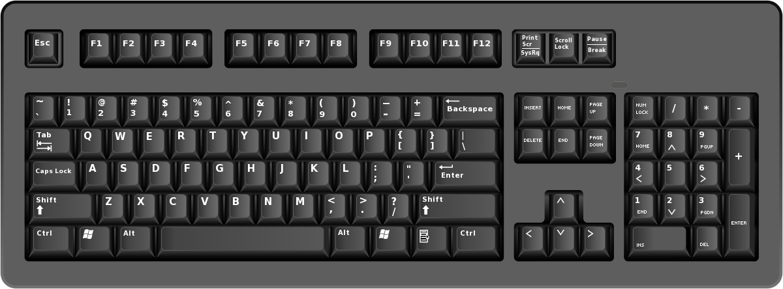
Stream: Input Stream
The flow of data from input device to memory is called InStream
10A0X2
F100A3
1D00X4
Memory
Notes:
After this lecture, you shall be able to explain the Hardware Components (that are input output devices, CPU and memory) and their role while computing any problem.

Slide 12

Stream: Output Stream
The flow of data from memory to output device is called OutStream.
10A0X2
F100A3
1D00X4
Memory
Notes:
After this lecture, you shall be able to explain the Hardware Components (that are input output devices, CPU and memory) and their role while computing any problem.

Slide 13
Stream: Input/Output Stream
If we want to write on console or read from console, we have already used IOSTREAM library.
#include <iostream>
Notes:
After this lecture, you shall be able to explain the Hardware Components (that are input output devices, CPU and memory) and their role while computing any problem.

Slide 14
Revision: Working Example
Write a program that takes names of students from the user and then displays them on the console.
Let's see the solution in terms of functions.
Notes:
After this lecture, you shall be able to explain the Hardware Components (that are input output devices, CPU and memory) and their role while computing any problem.

Slide 15
#include <iostream>
using namespace std;
// Function Prototype
void inputNames(string names[], int size, int &namesIndex);
void displayNames(string names[], int namesIndex);
main()
{
const int size = 100;
string names[size];
int namesIndex = 0;
inputNames(names, size, namesIndex);
displayNames(names, namesIndex);
}
// Function Definition
void displayNames(string names[], int namesIndex)
{
cout << "Names of the Students are:" << endl;
for (int i = 0; i < namesIndex; i = i + 1)
{
cout << names[i] << endl;
}
}
void inputNames(string names[], int size, int &namesIndex)
{
string option;
while (namesIndex < size)
{
cout << "Enter the Name or Enter 'No' to Exit: ";
cin >> option;
if (option == "No" || option == "no")
{
break;
}
else
{
names[namesIndex] = option;
namesIndex = namesIndex + 1;
}
}
}
Notes:
After this lecture, you shall be able to explain the Hardware Components (that are input output devices, CPU and memory) and their role while computing any problem.

Slide 16
Revision: Working Example
Do you see any limitation in this program?
Notes:
After this lecture, you shall be able to explain the Hardware Components (that are input output devices, CPU and memory) and their role while computing any problem.

Slide 17
Input/Output Stream: Limitation
Inputting data in a program from the keyboard is comfortable as long as the amount of input is very small.
Sending output to the screen works well if the amount of data is small (no larger than the size of the screen) and you do not want to distribute the output in a printed format to others.
As soon as the program terminates, the data in the memory (RAM) is deleted.
Notes:
After this lecture, you shall be able to explain the Hardware Components (that are input output devices, CPU and memory) and their role while computing any problem.

Slide 18
Input/Output Stream: Limitation
So, what is the solution?
Notes:
After this lecture, you shall be able to explain the Hardware Components (that are input output devices, CPU and memory) and their role while computing any problem.

Slide 19
File Stream
If we need to store data permanently, we have to store it into the files.
Now, if we need to write or read from the file, we need to do it through FileStream.
#include <fstream>
Notes:
After this lecture, you shall be able to explain the Hardware Components (that are input output devices, CPU and memory) and their role while computing any problem.

Slide 20
File Stream
We have to open the file in the correct mode, before reading or writing in the file.
Sr. No. | Open Mode | Description
1 | ios::in | Open for reading
2 | ios::out | Open for writing
3 | ios::app | Append mode
Notes:
After this lecture, you shall be able to explain the Hardware Components (that are input output devices, CPU and memory) and their role while computing any problem.

Slide 21
File Stream: Writing in the File
Let’s say we want to write “Welcome to UET” in a text file.
string line = "Welcome to UET";
Notes:
After this lecture, you shall be able to explain the Hardware Components (that are input output devices, CPU and memory) and their role while computing any problem.

Slide 22
File Stream: Writing in the File
Writing in a file or Storing output in the file is a five-step process
Notes:
After this lecture, you shall be able to explain the Hardware Components (that are input output devices, CPU and memory) and their role while computing any problem.

Slide 23
Writing in the File: 5 Step Process
Step 1: Include the header file fstream in the program.
#include <fstream>
using namespace std;
main()
{
string line = "Welcome to UET";
}
Notes:
After this lecture, you shall be able to explain the Hardware Components (that are input output devices, CPU and memory) and their role while computing any problem.

Slide 24
Writing in the File: 5 Step Process
Step 2: Declare file stream variable to open the file.
#include <fstream>
using namespace std;
main()
{
string line = "Welcome to UET";
fstream newFile;
}
Notes:
After this lecture, you shall be able to explain the Hardware Components (that are input output devices, CPU and memory) and their role while computing any problem.

Slide 25
Writing in the File: 5 Step Process
Step 3: Associate the file stream variables with the text file and define the opening mode.
#include <fstream>
using namespace std;
main()
{
string line = "Welcome to UET";
fstream newFile;
newFile.open("TextFile.txt", ios::out);
}
Notes:
After this lecture, you shall be able to explain the Hardware Components (that are input output devices, CPU and memory) and their role while computing any problem.

Slide 26
Writing in the File: 5 Step Process
Step 3: Associate the file stream variables with the text file and define the opening mode.
#include <fstream>
using namespace std;
main()
{
string line = "Welcome to UET";
fstream newFile;
newFile.open("TextFile.txt", ios::out);
}
ios Input Output Stream :: Scope resolution operator which specifies the scope
Notes:
After this lecture, you shall be able to explain the Hardware Components (that are input output devices, CPU and memory) and their role while computing any problem.

Slide 27
Writing in the File: 5 Step Process
Step 4: Use the file stream variables insertion operator << (to store in the file).
#include <fstream>
using namespace std;
main()
{
string line = "Welcome to UET";
fstream newFile;
newFile.open("TextFile.txt", ios::out);
newFile << line;
}
Notes:
After this lecture, you shall be able to explain the Hardware Components (that are input output devices, CPU and memory) and their role while computing any problem.

Slide 28
Writing in the File: 5 Step Process
Step 5: Close the file.
#include <fstream>
using namespace std;
main()
{
string line = "Welcome to UET";
fstream newFile;
newFile.open("TextFile.txt", ios::out);
newFile << line;
newFile.close();
}
Notes:
After this lecture, you shall be able to explain the Hardware Components (that are input output devices, CPU and memory) and their role while computing any problem.

Slide 29
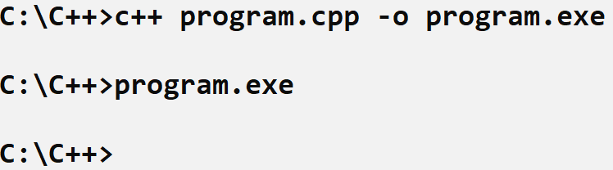
Output: Writing in the File
Now we will not see anything on the Console.
Notes:
After this lecture, you shall be able to explain the Hardware Components (that are input output devices, CPU and memory) and their role while computing any problem.

Slide 30
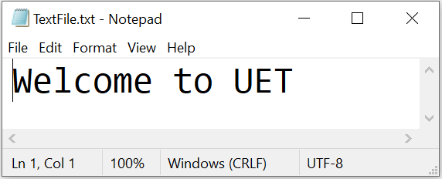
Output: Writing in the File
Now we will not see anything on the Console. But the output is permanently stored in a text file.
Notes:
After this lecture, you shall be able to explain the Hardware Components (that are input output devices, CPU and memory) and their role while computing any problem.

Slide 31
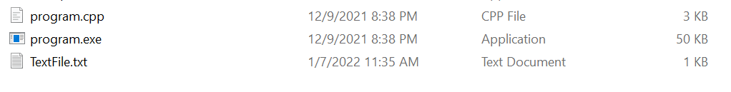
File in the Same Directory
Important thing to note the .txt file will be created in the same directory as that of our .exe file.
Notes:
After this lecture, you shall be able to explain the Hardware Components (that are input output devices, CPU and memory) and their role while computing any problem.

Slide 32
Activity
Write a program to input five names in an array and then create a file named as names.txt and store the values from the array in the text file.
Notes:
After this lecture, you shall be able to explain the Hardware Components (that are input output devices, CPU and memory) and their role while computing any problem.

Slide 33
Activity Skeleton Code:
#include <iostream>
#include <fstream>
using namespace std;
void inputNames(string names[]);
void storeNames(string names[]);
main () {
string names[5];
inputNames(names);
storeNames(names);
}
Notes:
After this lecture, you shall be able to explain the Hardware Components (that are input output devices, CPU and memory) and their role while computing any problem.

Slide 34
Activity Solution:
#include <iostream>
#include <fstream>
using namespace std;
void inputNames(string names[]);
void storeNames(string names[]);
main () {
string names[5];
inputNames(names);
storeNames(names);
}
void inputNames(string names[])
{
for(int idx=0;idx<5;idx++)
{
cout<<"Enter Name:";
cin>>names[idx];
}
}
Notes:
After this lecture, you shall be able to explain the Hardware Components (that are input output devices, CPU and memory) and their role while computing any problem.

Slide 35
Activity Solution:
#include <iostream>
#include <fstream>
using namespace std;
void inputNames(string names[]);
void storeNames(string names[]);
main () {
string names[5];
inputNames(names);
storeNames(names);
}
void inputNames(string names[])
{
for(int idx=0;idx<5;idx++)
{
cout<<"Enter Name:";
cin>>names[idx];
}
}
void storeNames(string names[])
{
fstream file; file.open("data.txt",ios::out);
for(int idx=0;idx<5;idx++)
{
file << names[idx];
file << "\n";
}
file.close();
}
Notes:
After this lecture, you shall be able to explain the Hardware Components (that are input output devices, CPU and memory) and their role while computing any problem.

Slide 36

Learning Objective
Understand the limitations of taking input and displaying on the console.
Notes:
After this lecture, you shall be able to explain the Hardware Components (that are input output devices, CPU and memory) and their role while computing any problem.

Slide 37
Learning Objective
Write C++ Program that creates a text file and store data into the permanent storage.
Notes:
After this lecture, you shall be able to explain the Hardware Components (that are input output devices, CPU and memory) and their role while computing any problem.

Slide 38


Conclusion
The limitations of using input and output streams are:
Inputting data in a program from the keyboard is comfortable as long as the amount of input is very small.
Sending output to the screen works well if the amount of data is small and one does not want to distribute the output in a printed format to others.
As soon as the program terminates, the data in the memory (RAM) is deleted.
Notes:
If we adopt Project Based approach for learning programming, and divide our problem into small computational steps, and learn the related Syntax.
Then using this approach we can make our own Games, Websites and Mobile Apps easily.

Slide 39
Conclusion
If we need to store data permanently, we have to store it into the files.
Now, if need to write or read from the file, we need to do it through FileStream.
Notes:
If we adopt Project Based approach for learning programming, and divide our problem into small computational steps, and learn the related Syntax.
Then using this approach we can make our own Games, Websites and Mobile Apps easily.

Slide 40
Conclusion
Storing output in the file is a five-step process:
Include the header file fstream in the program.
Declare file stream variables.
Associate the file stream variables with the text file and define the opening mode.
Use the file stream variables insertion operator << (to store output in the file i.e., write in the file)
Close the file.
Notes:
If we adopt Project Based approach for learning programming, and divide our problem into small computational steps, and learn the related Syntax.
Then using this approach we can make our own Games, Websites and Mobile Apps easily.

Slide 41

Self Assessment
1. Develop a Signup Application using File System.
As a user, when I SignUp to the system the username and password stores into the file.

